Slide 1
Music Company Database
Group No. 04

Slide 2
Group Members
Anurag Ganguly (13000117125)
Anupam Chakraborty (13000117126)
Aniket Das (13000117130)
Ananya Paul (13000117131)

Slide 3
Abstract
A Database is collection of data relevant to a particular enterprise.
SQL is a database computer language used for the retrieval and management of data in a relational database.
SQL stands for Structured Query Language.
A Music Company Database enables a user to insert, update, and retrieve information related to songs, artists, albums, lyricists, producers.

Slide 4
Introduction
This project consists of Extended Entity Relationship Diagram and Relational Model of the database.
Several SQL queries are executed to insert, update, delete and retrieve meaningful information from database.
Queries consisting of DCL, DDL, DML, DQL commands, sets, aggregate operators have been included as well.

Slide 5
What’s SQL?
Developed by Donald D.Chamberlin and Raymond F.Boyce in 1974
Domain-specific language used in programming.
Designed for storing, managing, manipulating and retrieving data held in a relational database management system(RDBMS).
Allows users to set permission on tables, procedures and views.
Allows to embed within other languages using SQL modules, libraries and pre-compilers

Slide 6
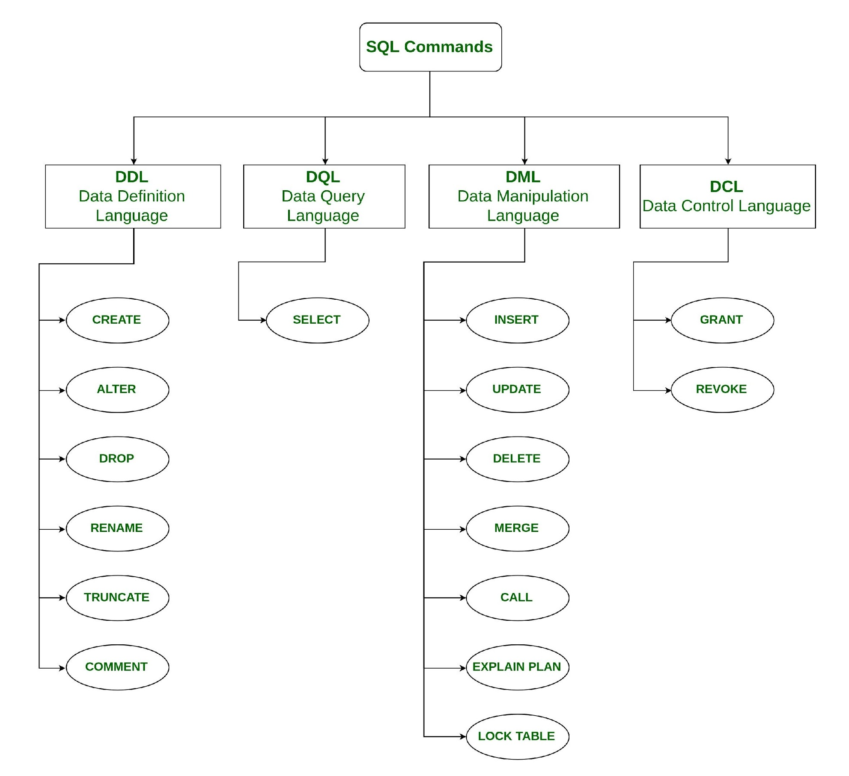
Types of SQL Commands

Slide 7
Structure of Database
SONGS (S_ID, S_Name, Artist_ID, Album_ID, Lyricist_ID, Composer_ID, P_ID, S_Sales)
ARTISTS (Artist_ID, Ar_Name, Ar_Sex, Ar_DOB, Ar_Age)
ALBUM (Album_ID, Genre, R_Date , NO_Downloads, NO_Sales)
COMPOSER (C_ID,C_Name,Sex,Age,DOB,S_ID)
LYRICIST (Lyricist_ID, L_Name, L_Sex, L_DOB, L_Age)
PRODUCER (P_ID, P_Name, P_Sex, P_DOB, P_Age)

Slide 8
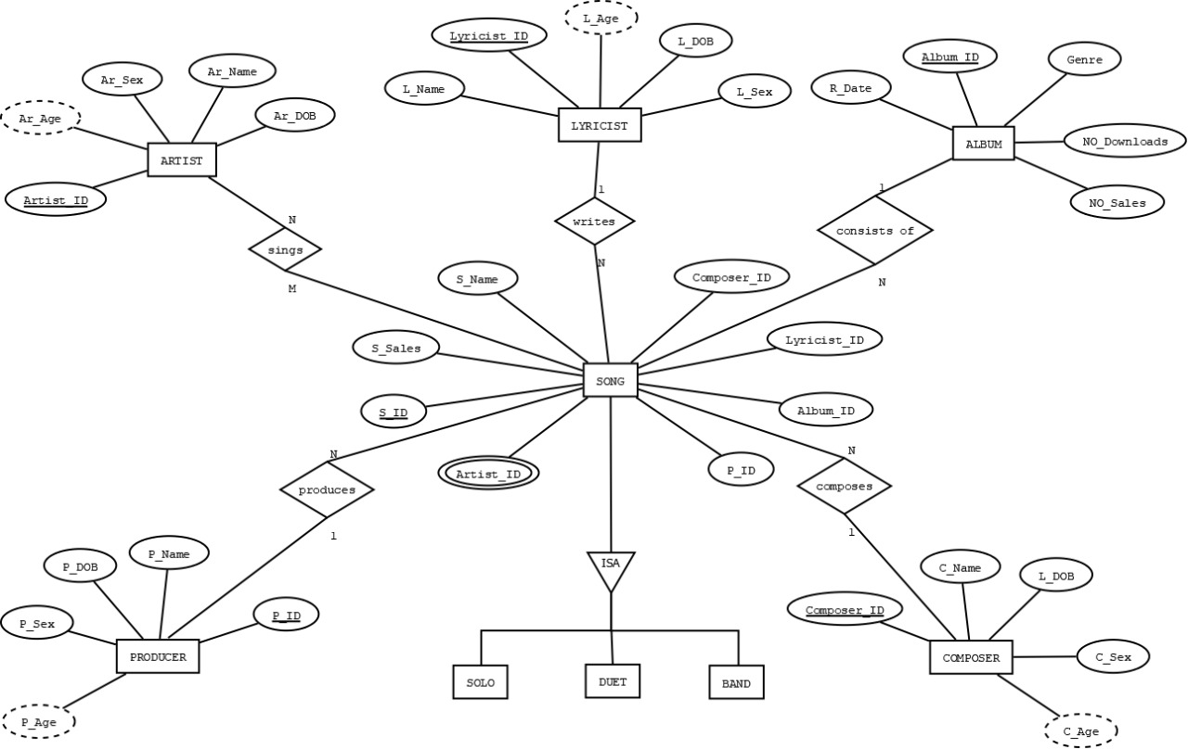
EER Diagram

Slide 9
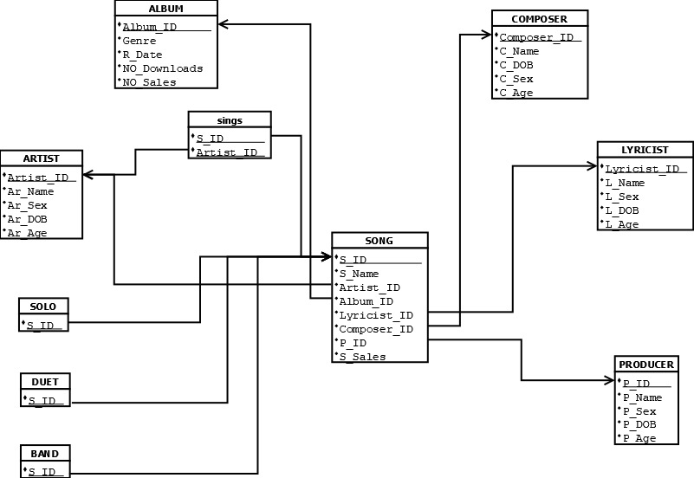
Relational Model

Slide 10
Normalization
Normalization is the process of organizing data in the database
Normalization is used to minimize the redundancy from a relation or a set of relations.
Eliminates three types of anomalies namely: - Insertion, Updation and Deletion.
The most commonly used normal forms are :- 1NF, 2NF, 3NF and BCNF

Slide 11
Normalisation & Our Tables
Our database is normalized and it is in BCNF(Boyce Codd’s Normal Form)
Reason :-
Atomicity preserved satisfying 1NF
No non-prime attributes is dependent on the proper subset of the candidate key, satisfying 2NF
Removal of transitive functional dependency and ensuring each of the attributes is directly dependent on the super key/candidate key, satisfying 3NF
Since, all the attributes from each and every table are strictly dependent on the super key, thus database is in BCNF(Stricter form of 3NF)

Slide 12
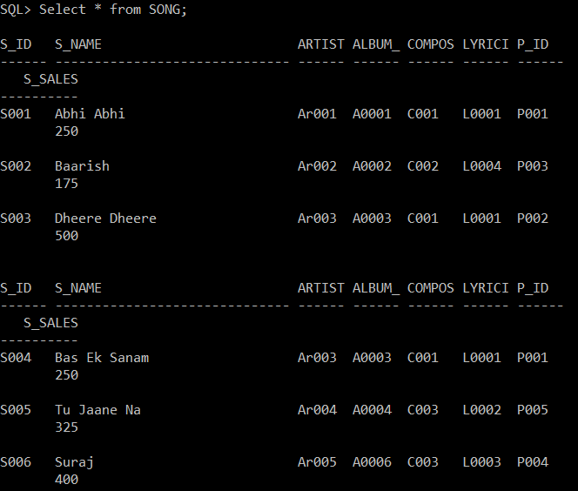
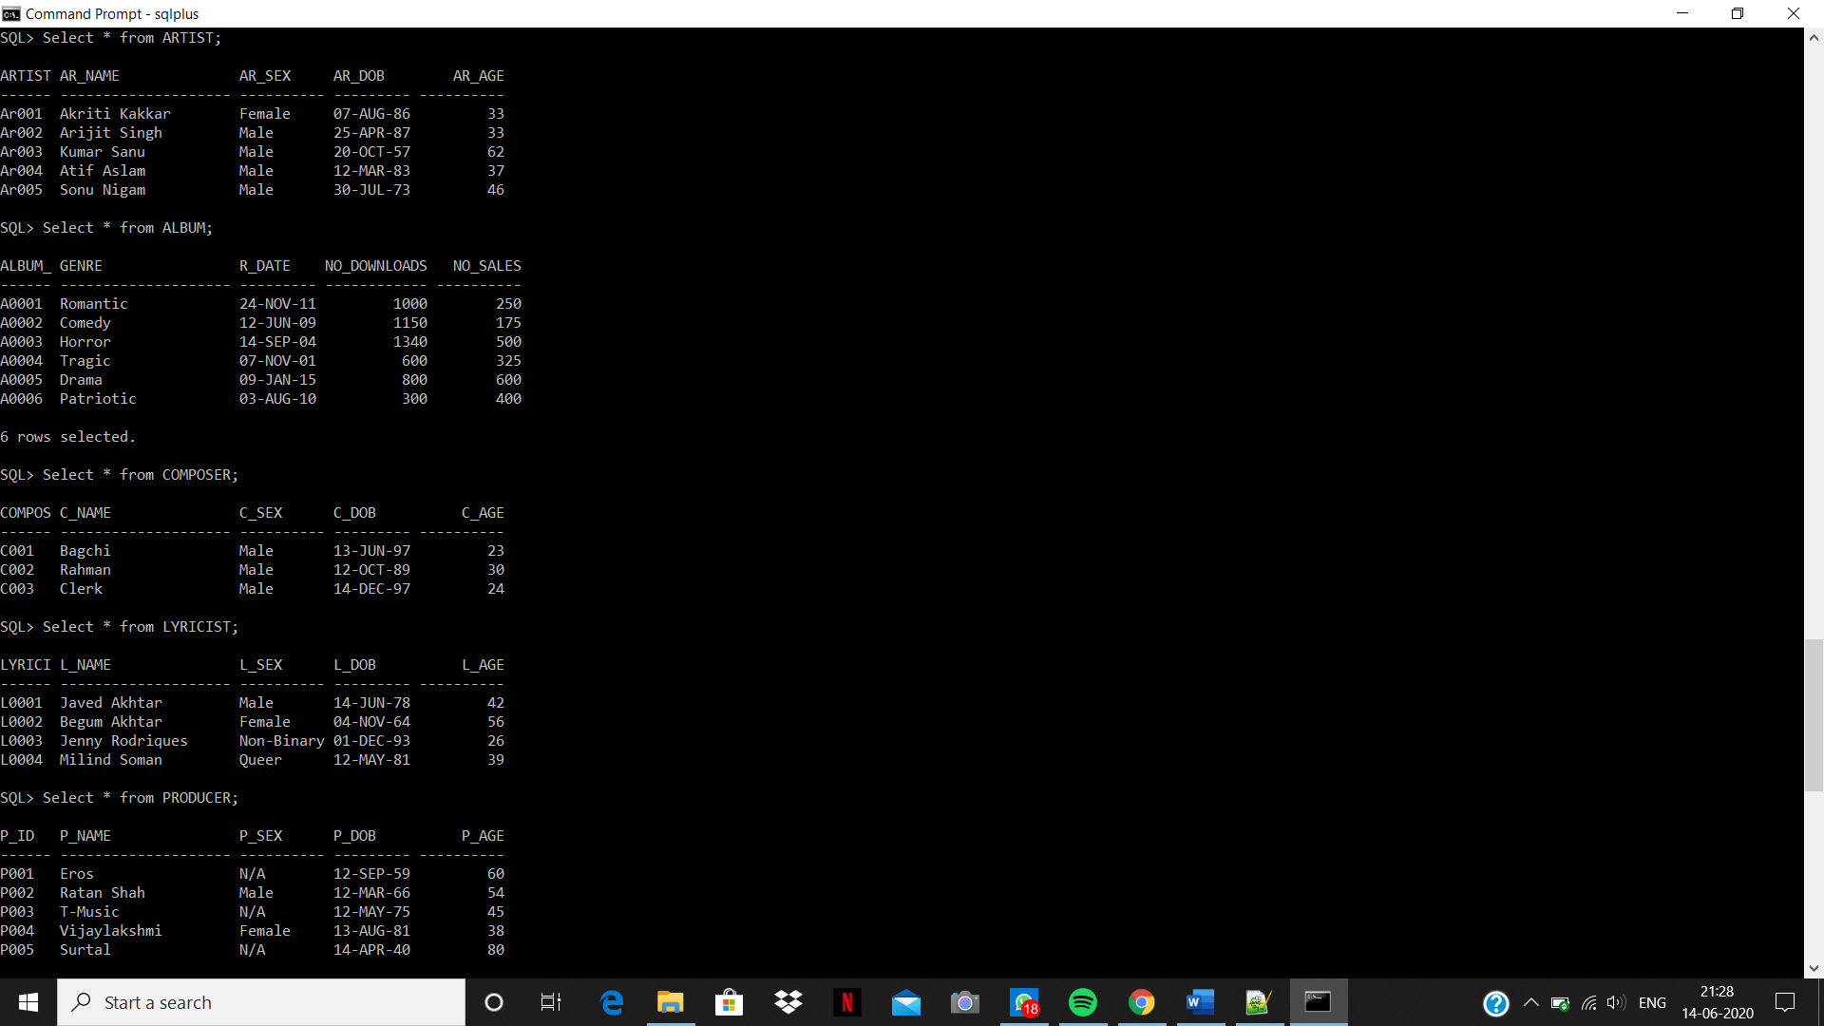
Insertion

Slide 13
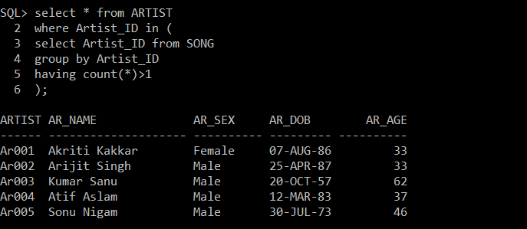
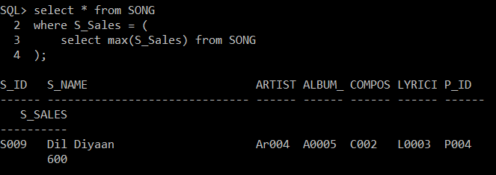
Queries
The names of artists who have recorded more than one song:
List the most populous sung by an artist:

Slide 14
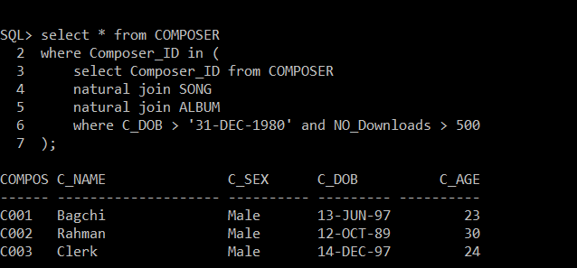
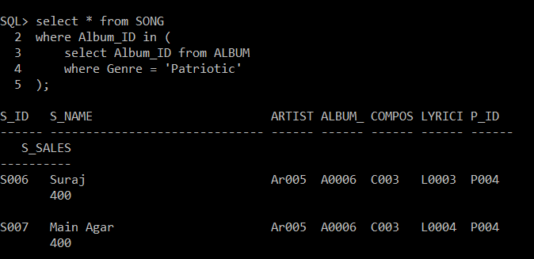
Queries
The composers who have been born after 1980, and whose albums have been downloaded more than 500 times:
The patriotic songs recorded by multiple artists produced after 1990:

Slide 15
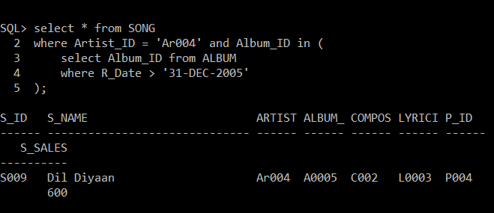
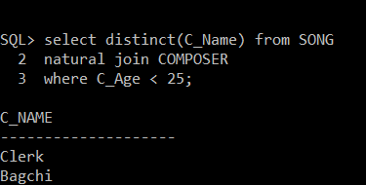
Queries
The songs sung by "Atif Aslam" under the banner "T-Music" after 2005:
The names of all composers aging below 25 who have composed at most 2 songs:

Slide 16
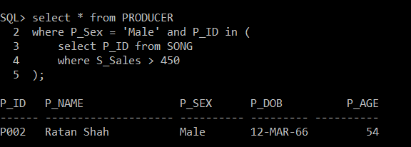
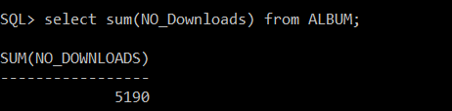
Queries
The songs produced by male producers whose sales have crossed 450:
The total downloads' count:

Slide 17
Scope
The Music Company Database can be enhanced further to create a grand database to hold huge entries of data ranging from different songs, artists produced under different production companies or independent producers.
This project is just a miniature reflection of our ideas which we would try to accomplish in the near future.

Slide 18
Conclusion
The project can be enhanced in its performance with the use of Embedded SQL. A ‘C’ program can be interfaced with SQL queries using connection libraries.
We aim to create an API to interact with database servers.
We can use the concept of Bigtable - A fully managed, scalable NoSQL database service for large analytical and operational workloads.
The future scope enlists multiple dimensions in magnifying the utility of our project.

Slide 19
Bibliography
We have prepared our project by taking help from various online sources. These have been mentioned below:
https://www.w3schools.com/sql
https://beginnersbook.com/2015/04/dbms-tutorial
Jenny’s Lectures on DBMS (Youtube)
Database system concepts by Henry F.Korth, Silberschatz Abhraham
NPTEL Lectures on DBMS by Professor Partha Pratim Das
Apart from these, the lecture notes provided by our Professor Poulomi Dutta have been of immense help.

Slide 20
Thank You :D

